Slide 1
Trends in spectrally resolved Outgoing Longwave Radiation from 10 years of satellite measurements
Simon Whitburn¹
L. Clarisse¹, A. Delcloo², S. Dewitte², M. Bouillon³, M. George³,
S. Safieddine³, P.-F. Coheur¹, C. Clerbaux^{1,3}
¹ Spectroscopy, Quantum Chemistry and Atmospheric Remote Sensing (SQUARES),
Université Libre de Bruxelles, Brussels, Belgium (simon.whitburn@ulb.be)
² Royal Meteorological Institute of Belgium, Brussels, Belgium
³ LATMOS/IPSL, Sorbonne Université, CNRS, Paris, France

Slide 2
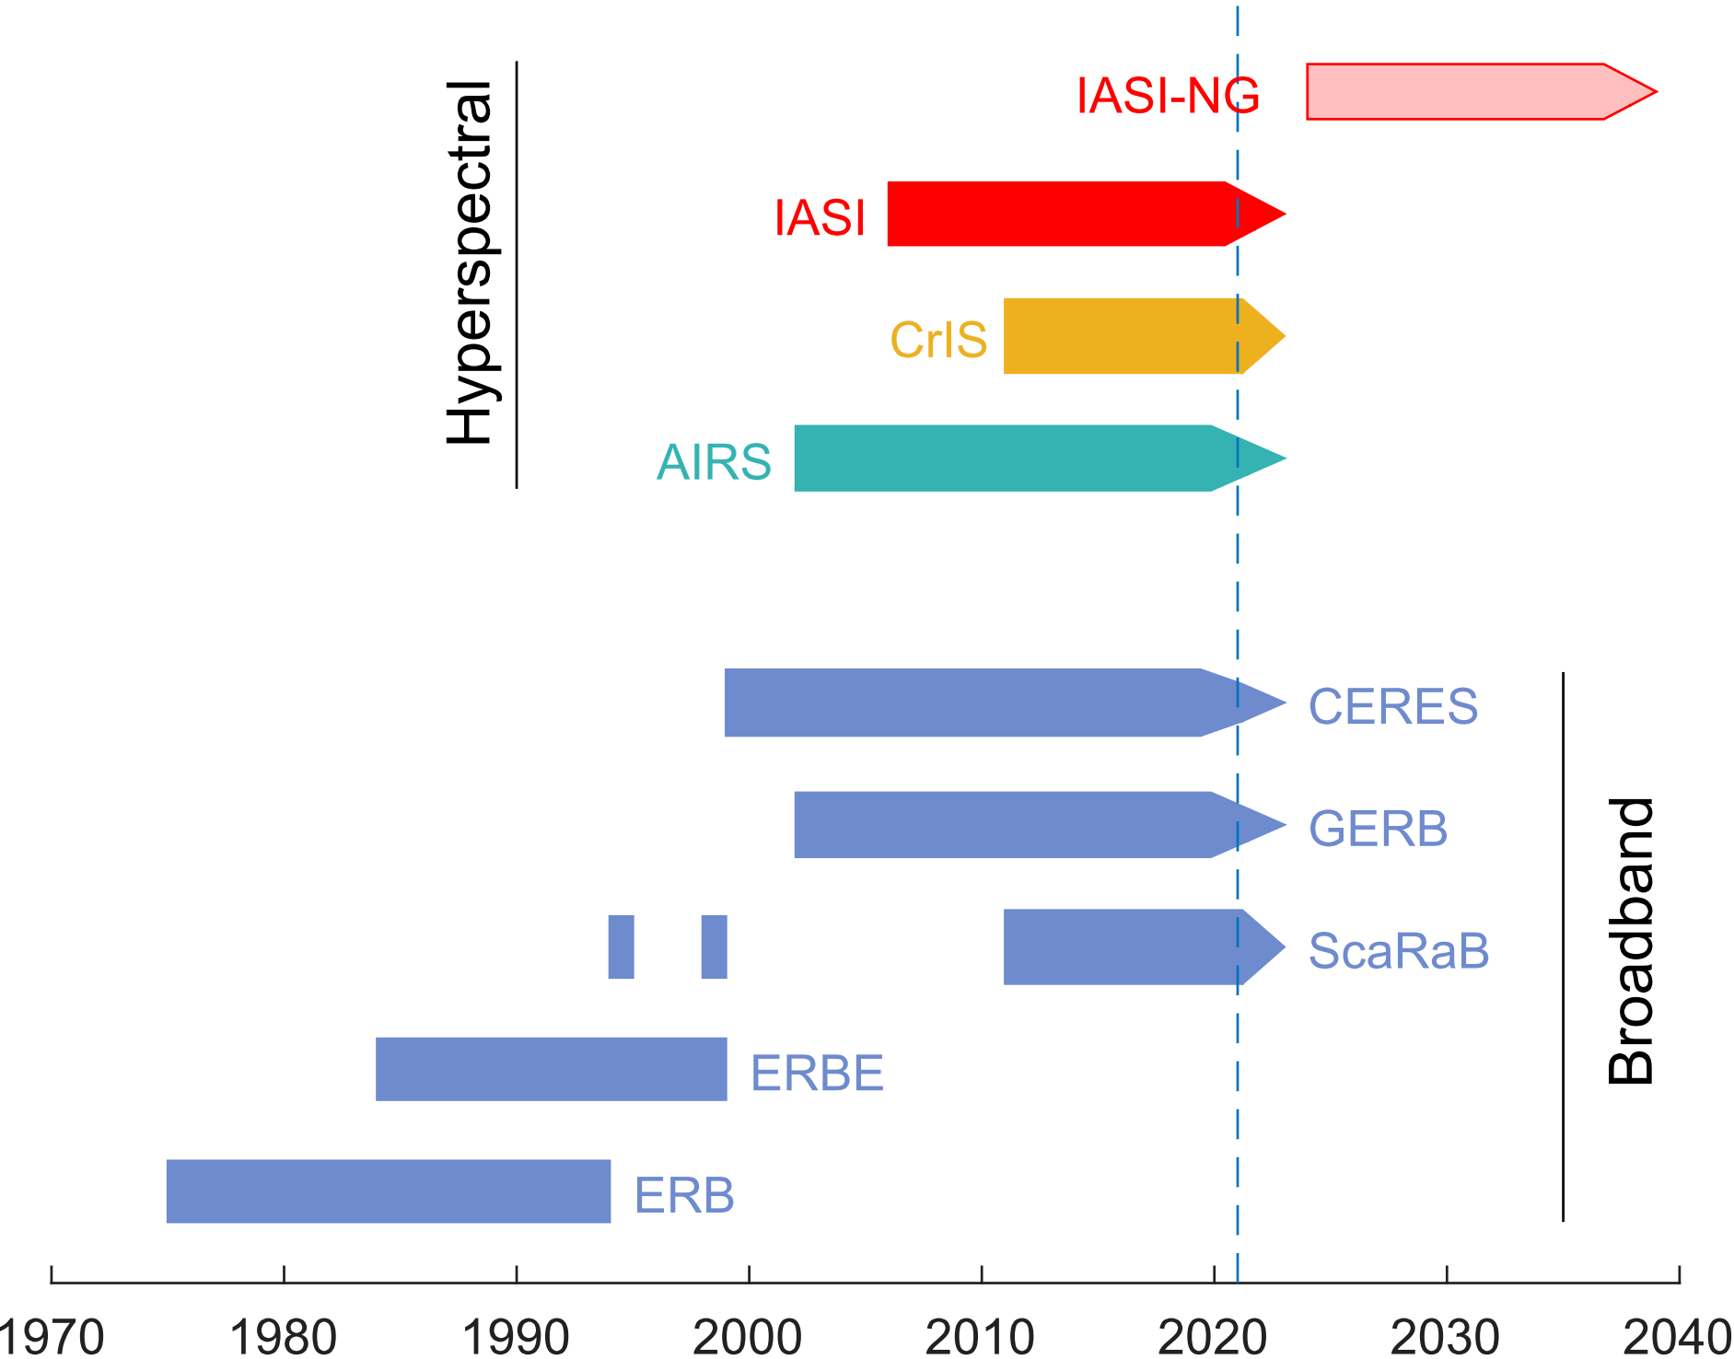
Context
Introduction OLR retrieval Trends Conclusions
Earth’s Outgoing Longwave Radiation (OLR) = total radiation emitted by the Earth-atmosphere system into space.
Climate change: importance of correctly evaluate the effects of the climate drivers and feedbacks on the OLR.
Spectrally integrated OLR (W m⁻²) from dedicated broadband instruments (e.g. CERES) available since 40 years.
Better constraints obtained from spectrally resolved OLR (i.e. the integrand of broadband OLR, W m⁻² (cm⁻¹)⁻¹) derived from infrared hyperspectral sounders.

Slide 3
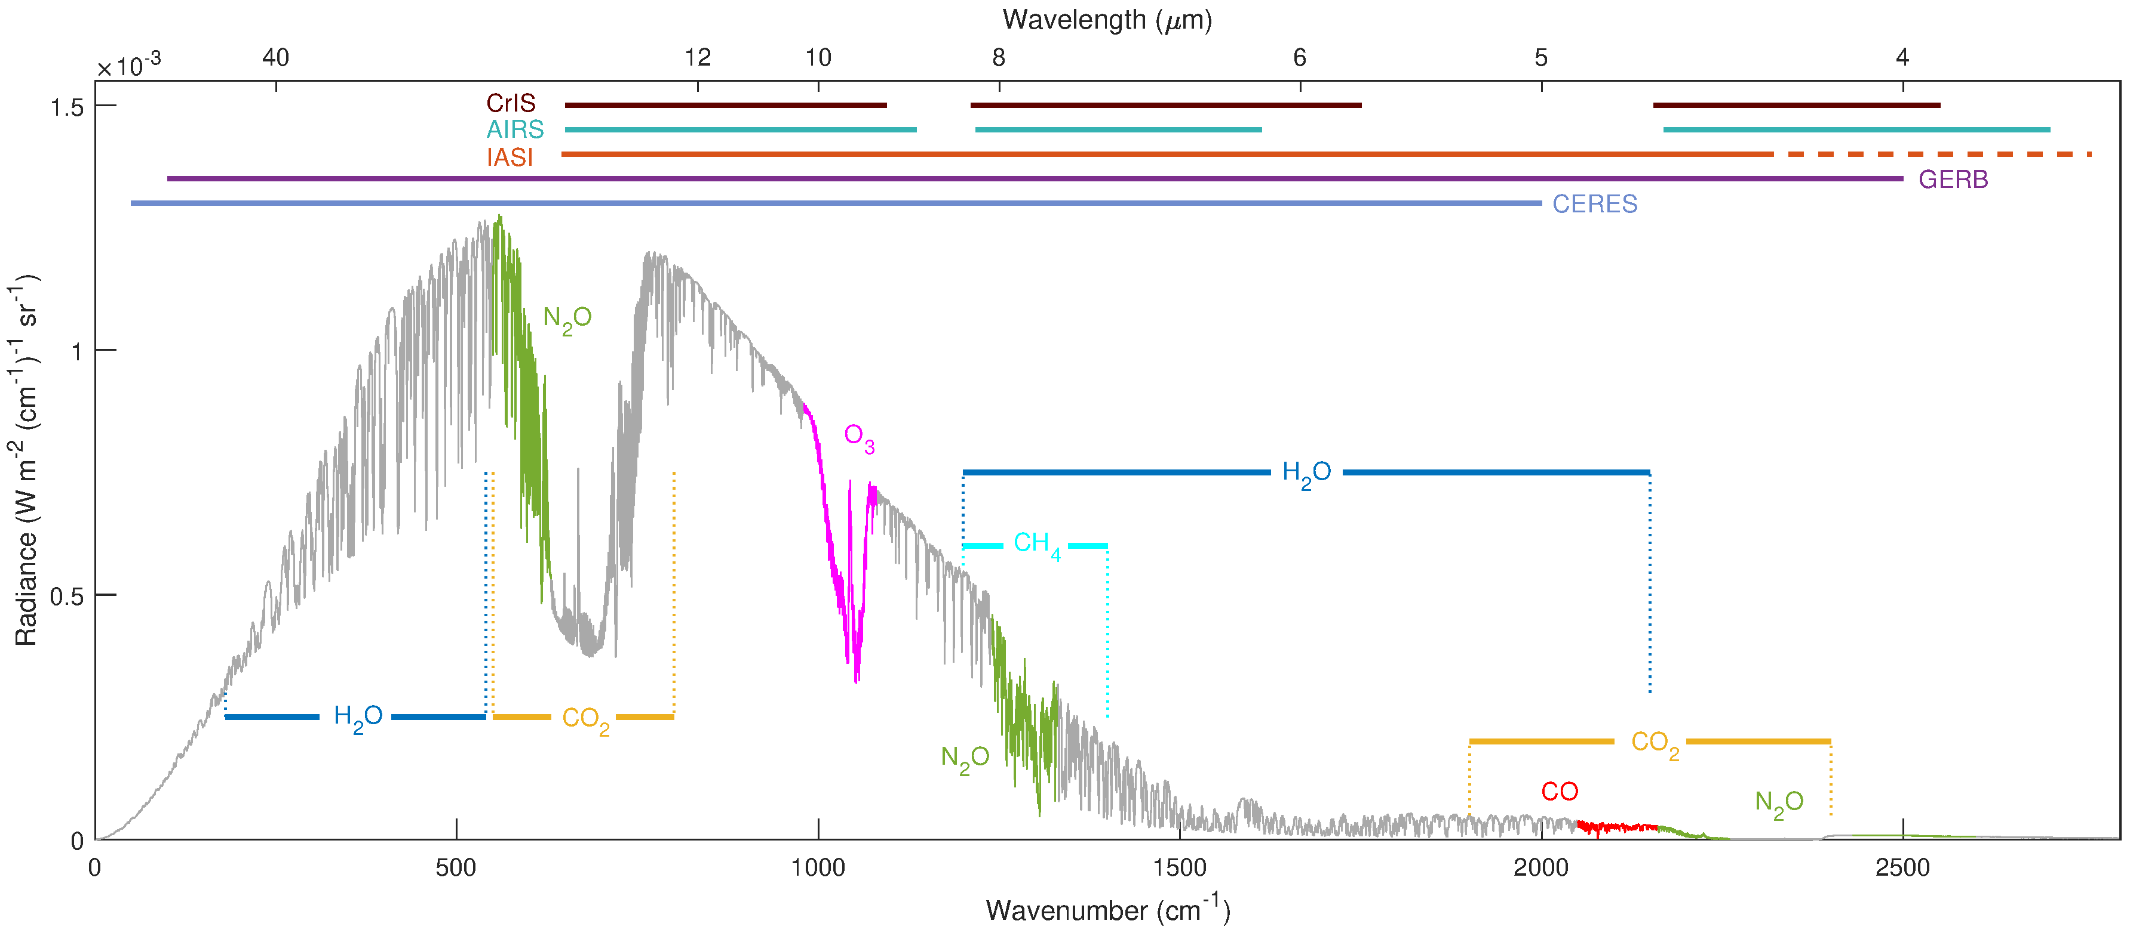
What ?
Introduction OLR retrieval Trends Conclusions
Changes in 10 years (2008-2017) of spectrally resolved OLR
Derived from the radiance measurements of IASI (reprocessed L1C dataset),
For clear-sky observations only,
At the spectral sampling of the instrument (0.25 cm⁻¹),
Between 645 and 2300 cm⁻¹.
Relation with known changes in greenhouse gases concentrations (CO₂, CH₄, …) and climate phenomena (ENSO, PDO, …)
→ First study at this spectral sampling, with any instrument !

Slide 4
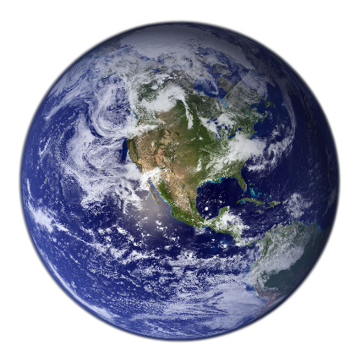
Radiance to OLR conversion
Introduction OLR retrieval Trends Conclusions
IASI/Metop
L_{ν} [W m⁻² sr⁻¹ (cm⁻¹)⁻¹]
F_{ν} [W m⁻² (cm⁻¹)⁻¹]
L_{ν}
$F\text{ν}$= $2π\int_{0}^{π/2}{L\text{ν}\left(θ\right)}sin\left(θ\right)\cos\left(θ\right)dθ$
$θ$ = zenith angle direction
IASI = single viewing angle direction (for a given scene) → direct integration over all the angles $θ$not possible
Anisotropy of the atmosphere taken into account through scene type dependant spectral correction factors $Rν\left(θ\right)$
$$F\text{ν}\text{=}\frac{π L\text{ν}\text{(}θ\text{)}}{R_{\text{ν}}\text{(}θ\text{)}}$$

Slide 5
Retrieval Method
Introduction OLR retrieval Trends Conclusions
$R\text{ν}\text{(}θ\text{)}$ depends on many surface and atmospheric parameters:
Tskin, Tprof, ε_{s}, H₂O, CO₂, O₃, CO, CH₄, N₂O, …
Key Step - Construction of a Look-up Table (LUT) of $R\text{ν}\text{(}θ\text{)}$
For a set of representative atmospheric and surface conditions (T_{s}, T_{a}, H₂O, O₃, CO₂, CH₄, N₂O, CO, ε_{s}; >100,000 different scenes in total)
From forward simulations using Atmosphit
For different viewing angles (θ)
Retrieval of the spectral OLR from IASI radiances by applying the right correction factor with the closest scene type.

Slide 6
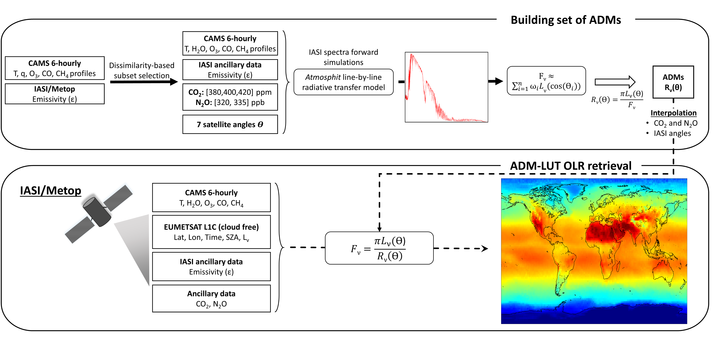
Introduction OLR retrieval Trends Conclusions

Slide 7
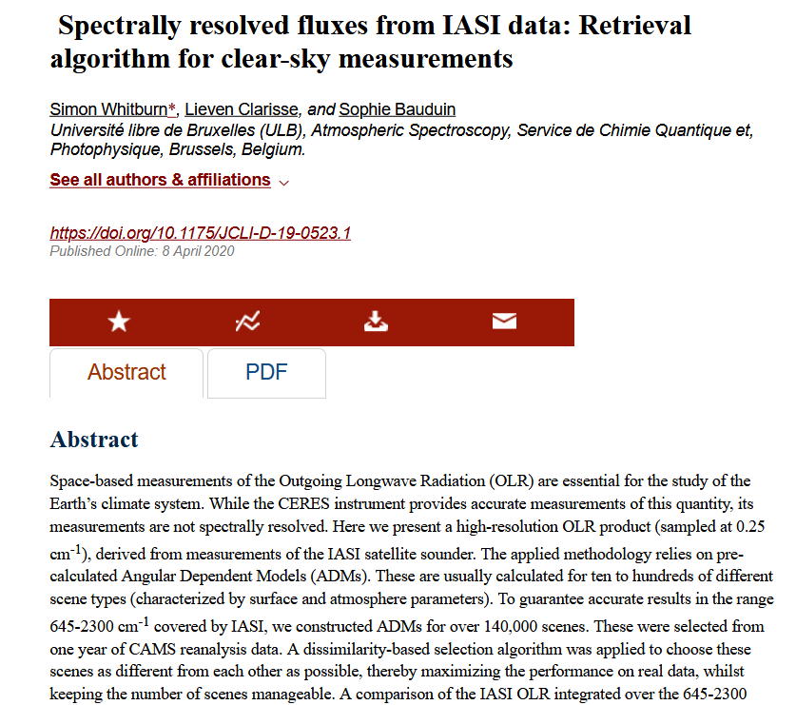
Introduction OLR retrieval Trends Conclusions
Method described in details in:
Whitburn et al. (2020) – JCLI

Slide 8
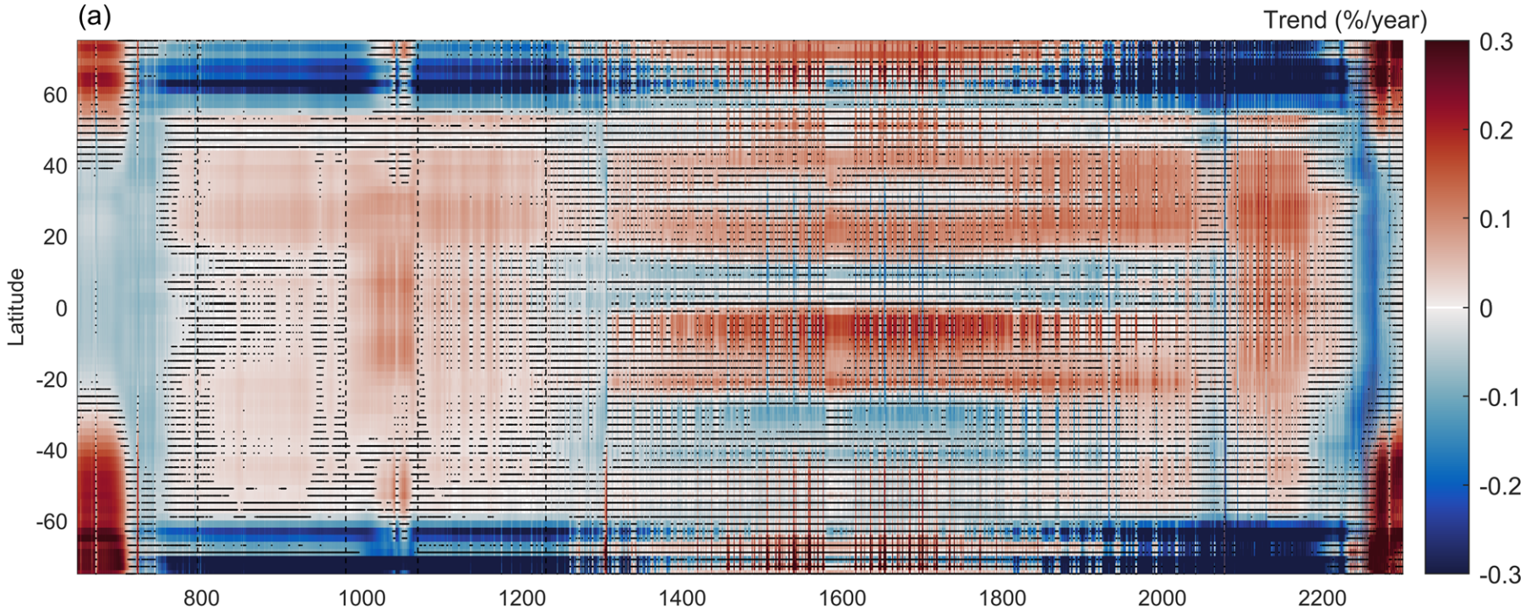
Trends in OLR for all IASI channels between 645 and 2300 cm⁻¹ (6621 in total)
Introduction OLR retrieval Trends Conclusions
From the daily mean OLR (2°x2° grid, daytime)
… between 2008-2017 and
… averaged per band of 2° of latitude
Trend expressed as % per year
Sea measurements only
Clear-sky observations only
Between 75°N and 75°S
Wavenumber (cm⁻¹)

Slide 9
Trends in OLR for all IASI channels between 645 and 2300 cm⁻¹ (6621 in total)
Introduction OLR retrieval Trends Conclusions
From the daily mean OLR (2°x2° grid, daytime)
… between 2008-2017 and
… averaged per band of 2° of latitude
Trend expressed as % per year
Sea measurements only
Clear-sky observations only
Between 75°N and 75°S
Wavenumber (cm⁻¹)
→ Reflect the changes in both atmospheric composition and surface and atmospheric temperatures

Slide 10
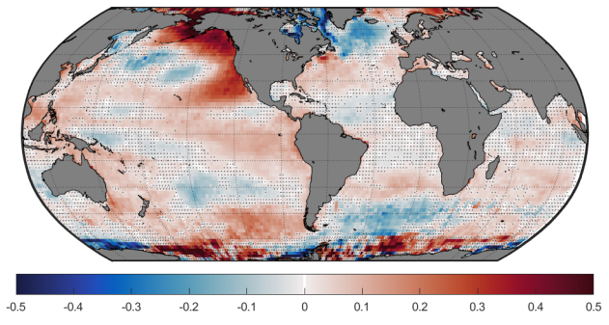
Introduction OLR retrieval Trends Conclusions
Short time period → many changes related to large scale climate phenomena …
Example 1 - atmospheric window: changes in Ts
Wavenumber (cm⁻¹)
PDO
North Atlantic Warming Hole
Global trend distribution of the OLR for the window region
El Niño
Antarctic Dipole
Trend (%/year)

Slide 11
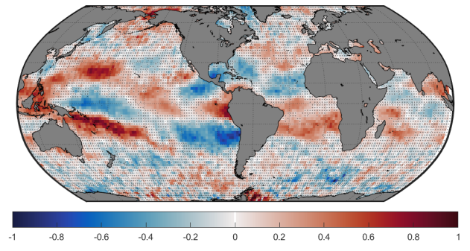
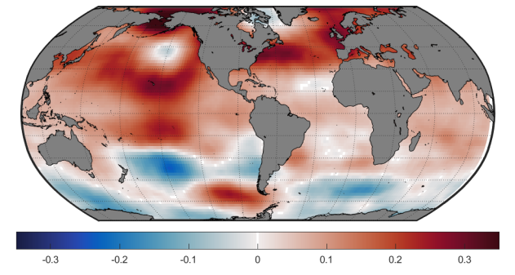
Introduction OLR retrieval Trends Conclusions
Short time period → many changes related to large scale climate phenomena …
Example 2- ν₂ H₂O band – mid-tropospheric sensitive channels:
Changes in H₂O concentrations
1441.25 cm⁻¹ (H₂O 500 hPa)
T_{atm} 500 hPa
El Niño
Trend (%/year)
Trend (%/year)

Slide 12
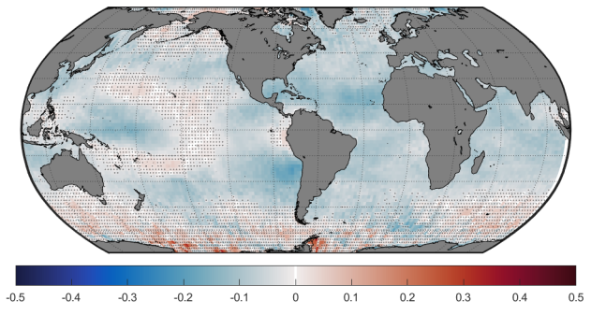
Introduction OLR retrieval Trends Conclusions
Evidence of changes in greenhouse gases concentrations
Example 1 - CO₂ tropospheric sensitive channel
Changes in CO₂ concentrations
↗ CO₂ concentrations → ↗ absorption → ↘ OLR
740.75 cm⁻¹ (CO₂ 500 hPa)
T_{atm} 500 hPa
Trend (%/year)
Trend (%/year)

Slide 13
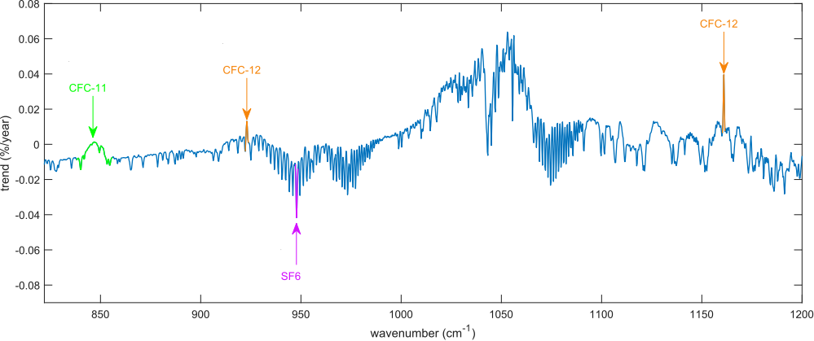
Introduction OLR retrieval Trends Conclusions
Evidence of changes in greenhouse gases concentrations
Example 2 - CFCs
Average of the zonal trends
Wavenumber (cm⁻¹)
↘ CFC-11 & CFC-12 → ↘ absorption → ↗ OLR
↗ SF6 → ↗ absorption → ↘ OLR

Slide 14
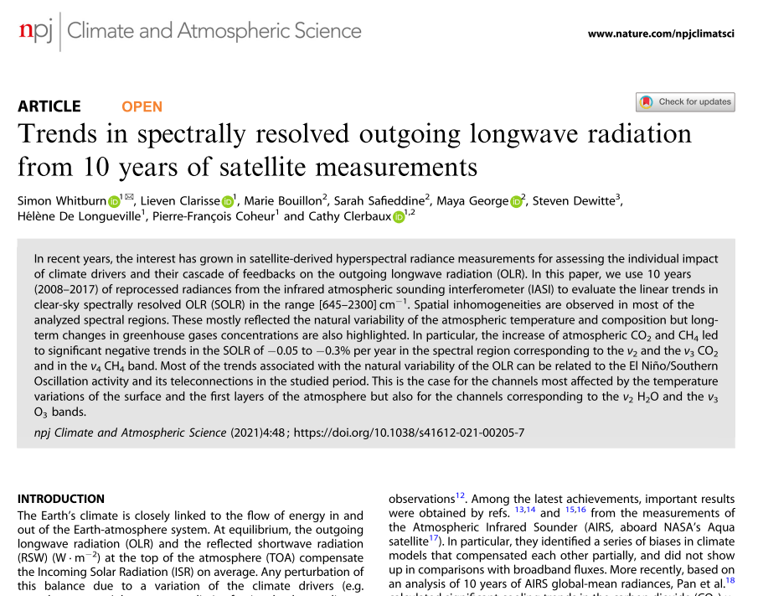
Introduction OLR retrieval Trends Conclusions
Spectrally resolved OLR trends
… at a spectral sampling of 0.25 cm⁻¹ (6621 channels in total).
Trends reflect both the temperature and atmospheric composition changes.
Short time period → many changes related to large scale climate phenomena (ENSO, PDO, … )
Evidence of long-term changes in greenhouse gas concentrations (CO₂, CH₄, CFCs) already observed.
Extension of the time series (IASI + IASI-NG) → climate feedbacks should become visible.
Data availability: Monthly mean spectral OLR at a 2°x2° spatial resolution https://iasi-ft.eu/data-access/OLR/.
Contact: simon.whitburn@ulb.be

